Slide 1
Plan Manager for Omnicast
Jonathan Doyon and Remi Breval
February 2011

Slide 2
Sipelia and Plan Manager
Sipelia (Paris) was a Genetec Technology Partner
Genetec acquired Sipelia in November 2010
  Expand Genetec’s custom solutions capabilities
  Plan Manager
Plan Manager for Omnicast started 5 years ago
  Paris Airport
  Stade de France
  TF1 (Television Francaise 1)
  Amsterdam Airport
  Lisbon Airport
Notes:
SDK Partner
They were very close to our Paris sales team, they developed a bunch of SDK applications for Security

Slide 3
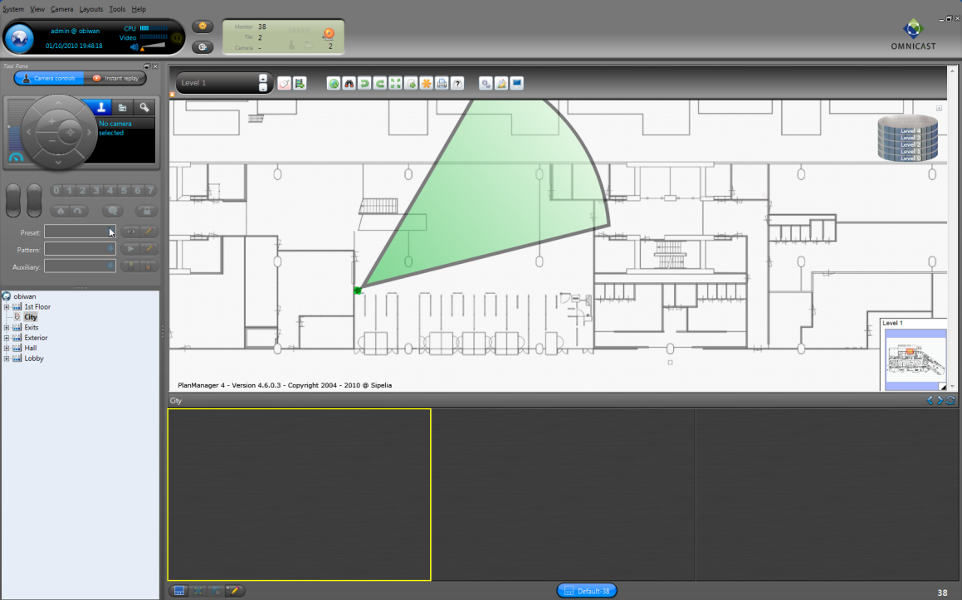
Enterprise-Class Mapping System
Runs inside Omnicast Live Viewer
Multi-floor, multi-building management
GIS support
Built-in alarm management
Scales to hundreds of client workstations
Extensible with Professional Services

Slide 4
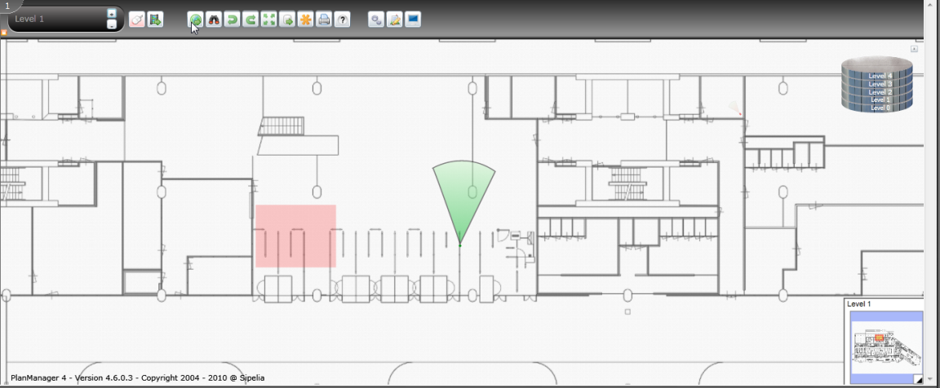
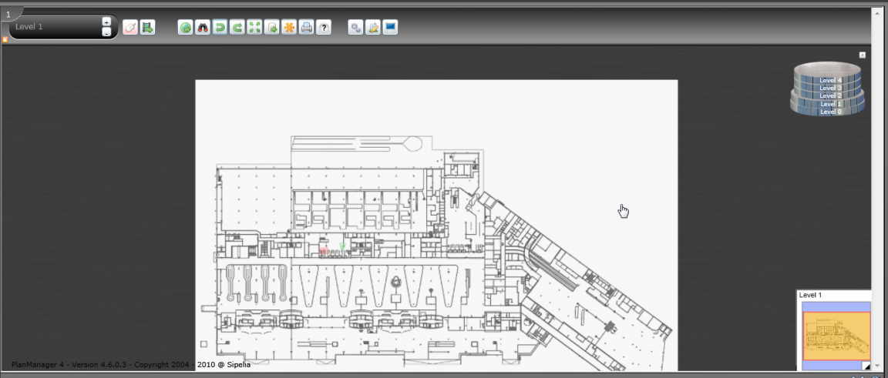
Advanced Mapping System
Support Vector PDF from CAD systems
  Autocad
  Microstation…
Advanced zooming capabilities
Update floor plans without changing cameras
Notes:
Most CAD system can export to Vector PDF,
Autocad has some free tool to select your layers and export them to PDF.
Basically in autocad you decide which layouts which layers you want to export
In fact any PDF can be imported in the system.

Slide 5
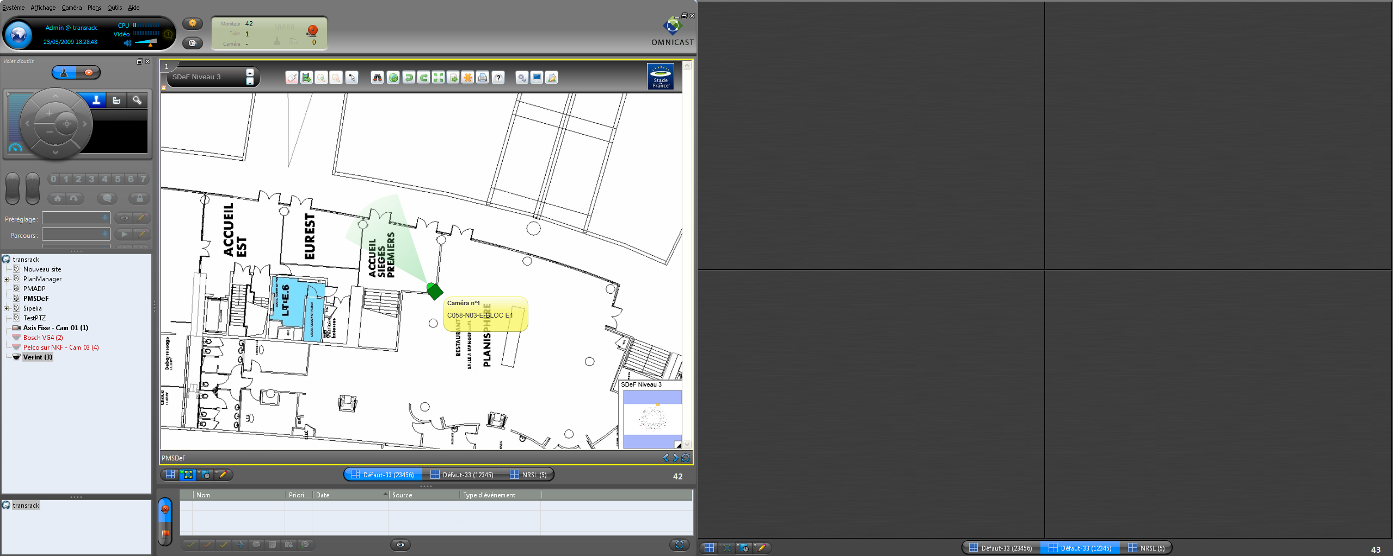
PTZ Field of View
Display the exact field of view
Automatically position cameras on a point of interest (Preset or fixed coordinates)
PTZ position overlay (Professional Service)
Supported PTZ cameras:
Axis (IP)
Bosch (IP and analog) new in 4.7
Panasonic (IP and analog)
Pelco D (Analog)
Sony (IP)
Samsung (Analog)
Checkpoint Clarity (Analog)
Notes:
Very easy to configure, position the camera on the floor plan, set the height of the PTZ, point the dome to a precis location and ajust the rotation angle on the map

Slide 6
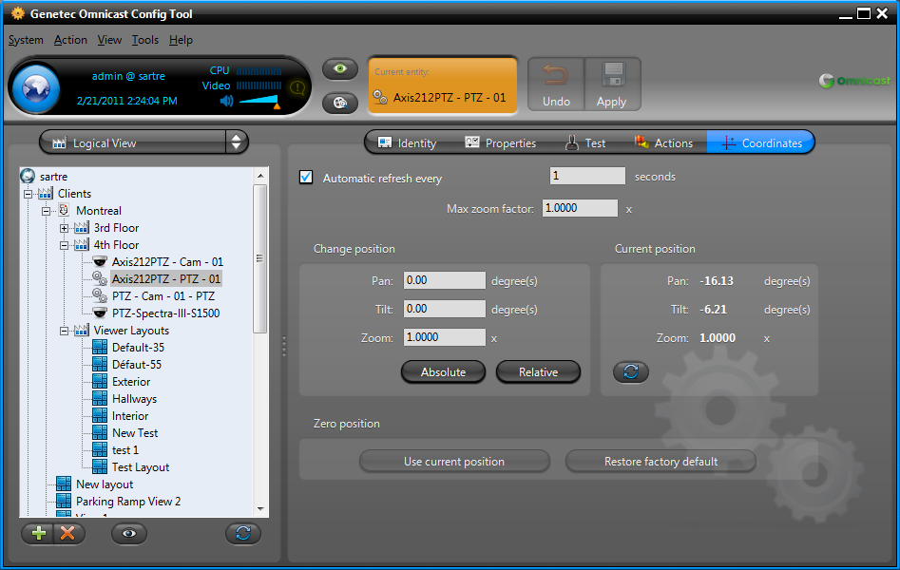
Is PTZ Feedback Supported ?

Slide 7
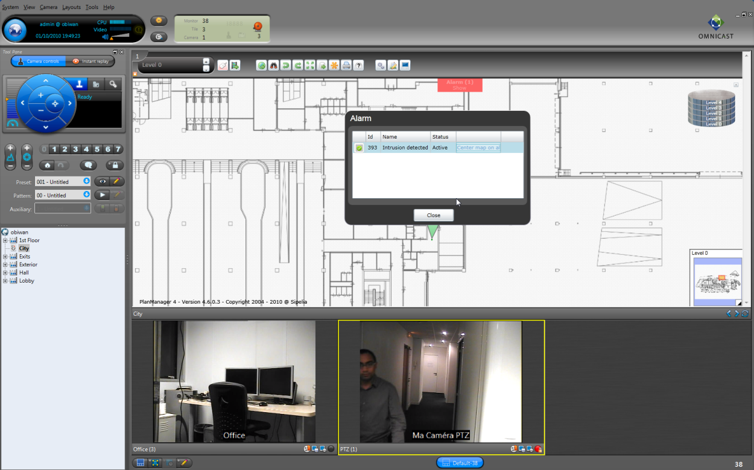
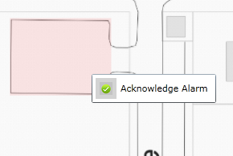
Alarm Management
Automatic alarm notifications
Easily locate alarms on the map
Browse between active alarms

Slide 8
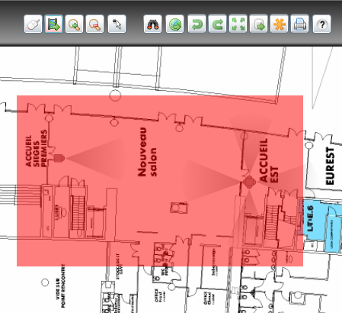

Intuitive User Interface
Same concepts as Google maps
Display multiple cameras by dragging
PAN
ZOOM
Configurable actions on mouse click
Automatically position PTZ cameras
View all cameras in an area

Slide 9
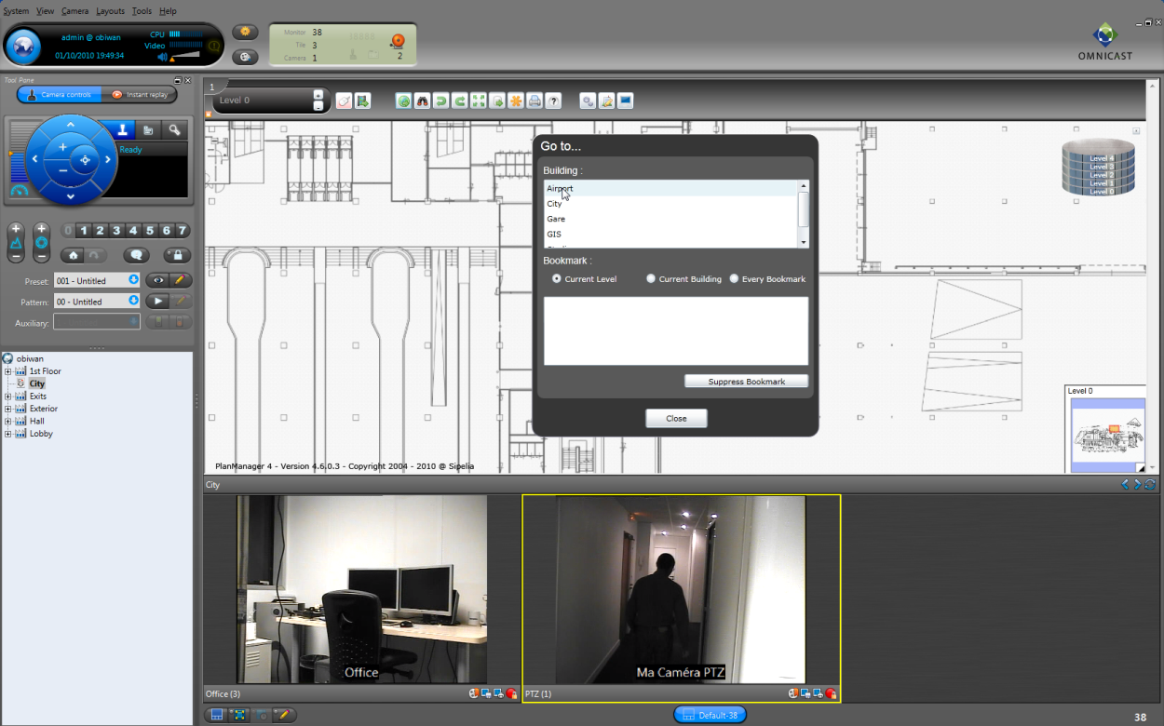
Smart Navigation
Search by camera names, description
Search floors and buildings
Public views and user-defined bookmarks
Ability to define link between maps

Slide 10
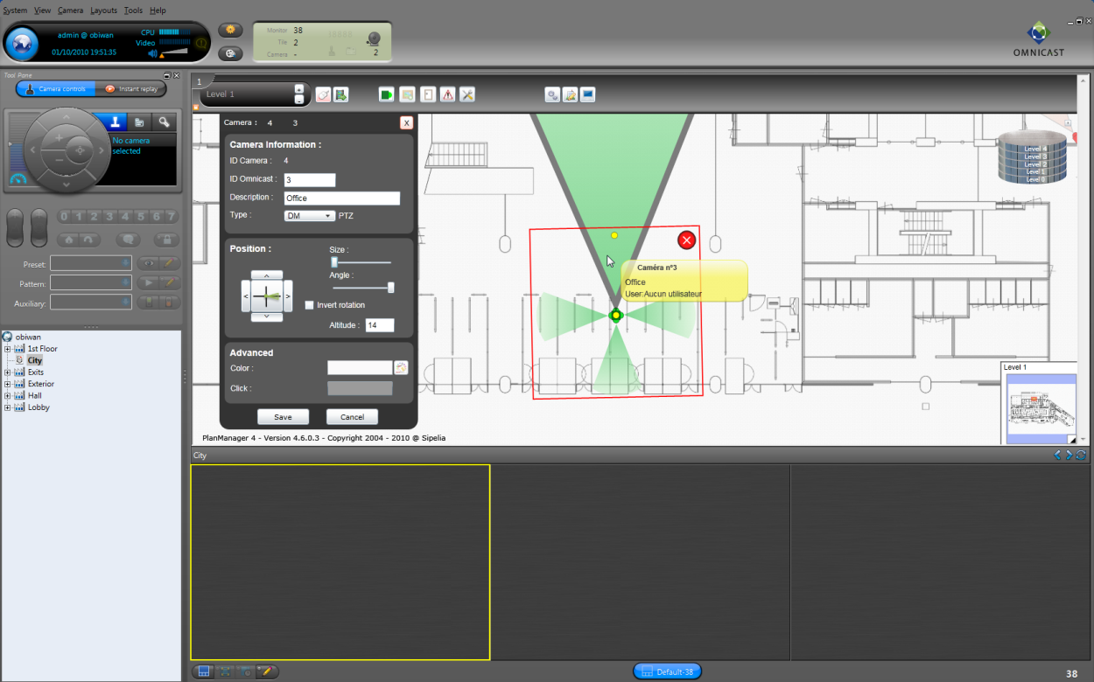
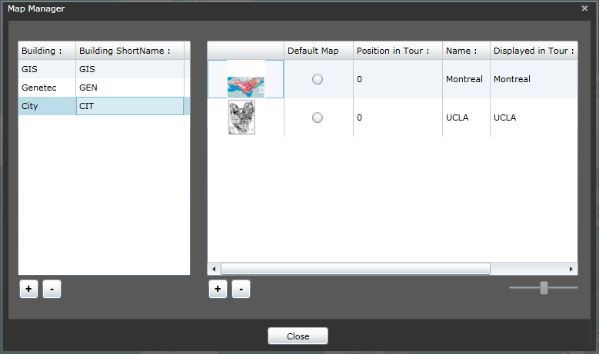
Built-in Map Designer
Simply drag and drop cameras
Adjust elevation and rotation angle for PTZ
Define floor and building hierarchy

Slide 11



Typical Architecture
Omnicast Directory
Plan Manager Server
Omnicast Live Viewer
SDK
Floor Plan
Notes:
Can run on the same server as Omnicast if the server meets the specifications (Omnicast Spec + Plan Manager Spec)

Slide 12
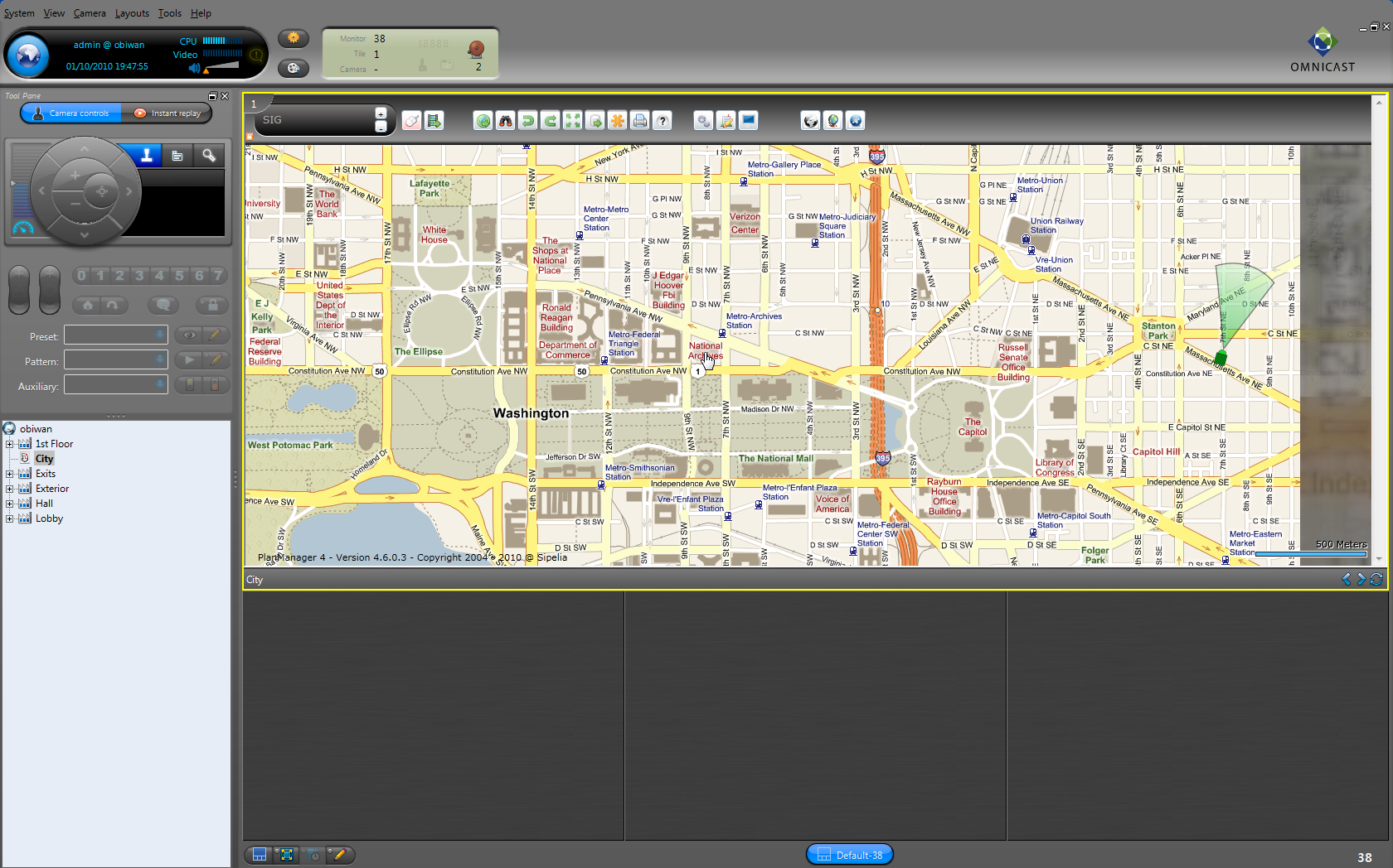
Geographical Information System
Easily link GIS and floor plan maps
GIS Servers from Open Geospatial Consortium (OGC)
OpenStreetMap.org
  Professional Service extends Plan Manager
  Esri ArcGIS and ArcView
  Proprietary GIS Server (City, Pipeline…)
  Microsoft Bing ($)
  Navteq ($)
  OGC Compatible servers (WMS 1.1)

Slide 13
Architecture with GIS Server
Omnicast Directory
Plan Manager Server
Omnicast Live Viewer
SDK
Internet WMS 1.1
Openstreetmap.org (GIS Server)
Open Geospatial Consortium (OGC)
Notes:
Local cache server
Standalone server for higher security

Slide 14
When Should I Use Plan Manager vs Omnicast Map Editor?
Omnicast Map Editor
Few small floor plans
Need something free
Plan Manager
Multiple levels and multiple buildings
Large floor plans
GIS map are requested
Center floor plan on alarms
PTZ field of view

Slide 15
Map Editor vs Plan Manager
Features | Omnicast Map Editor | Plan Manager
Configuration
Built-in Map Editor | ü | ü
Import BMP, JPEG | ü
Import PDF (from CAD system or raster image) |  | ü
Navigation
Show cameras in Live Viewer on click | ü | ü
Drag cameras from map to tile | ü | ü
View Multiple cameras at once |  | ü
Browse Floors and buildings |  | ü
Mini-Map (showing entire floor plan) |  | ü
Advanced zooming capabilities (GIS style) |  | ü
Global favorites views |  | ü
Private favorites views |  | ü
Search Favorites, cameras, building, floor |  | ü
Functions
Create hyperlinks between maps | ü | ü
Link Omnicast Alarms to a floor plan |  | ü
Center map on an Alarm |  | ü
Acknowledge alarm from the map |  | ü
Throw Omnicast custom events on click |  | ü
Move cameras to PTZ preset on click |  | ü
Move cameras to a precise PTZ position |  | ü
Show PTZ Field of view on Map |  | ü
Hot Actions |  | ü
Integration
Other GIS Server Support |  | Professional Service
GPS Tracking |  | Professional Service
Start Omnicast Macros from the map |  | Professional Service
Integrate Radar |  | Professional Service
Ship and Plan tracking |  | Professional Service
Reverse PTZ mapping based on 3D Model (Overlay) |  | Professional Service

Slide 16
Demo

Slide 17
Questions?

Slide 18
Extend Plan Manager with Professional Services
Launch Omnicast macros on user click
Other GIS systems (OGC)
Pipelines
Gas lines
Radar systems
Ships
Plan
GPS/REFID Tracking
Track vehicles
Track assets

