Slide 1

AutoVu Free-Flow

Slide 2
AutoVu™ Free-Flow
Launch webinar
November, 2015
Charles Pitman
Product Marketing Manager
Chris Yigit
Business Development Manager

Slide 3
Agenda for today
Overview of Off-street Parking
AutoVu™ Pay-by-Plate Sync
Introduction to Free-Flow
Free-Flow Tasks
Benefits

Slide 4
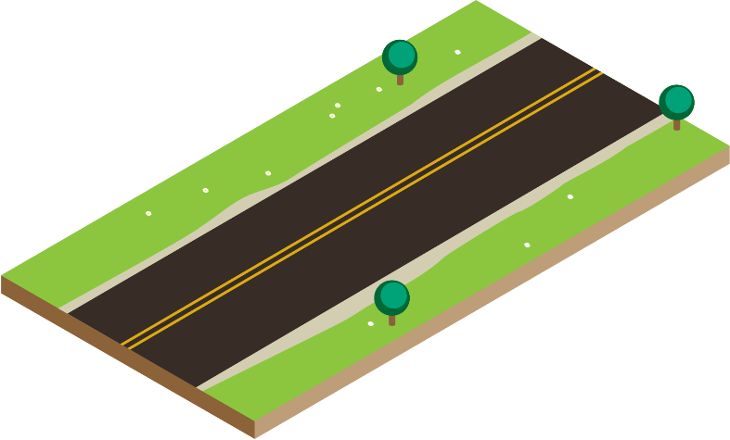



Classic Approach to Off-Street Parking

Slide 5


Challenges of the Gated solution

Slide 6




Challenges of the Gated solution
Notes:
Now, we all know how this really goes…
Show cars piling up.
You guys laugh, but we’re all parkers, in addition to being parking professionals, and we’ve all been there. And this is not a great customer experience.

Slide 7
Challenges Of Classic Gate Entry
Customer Experience
Stacking at Peak Hours
Maintenance
Not for everyone

Slide 8
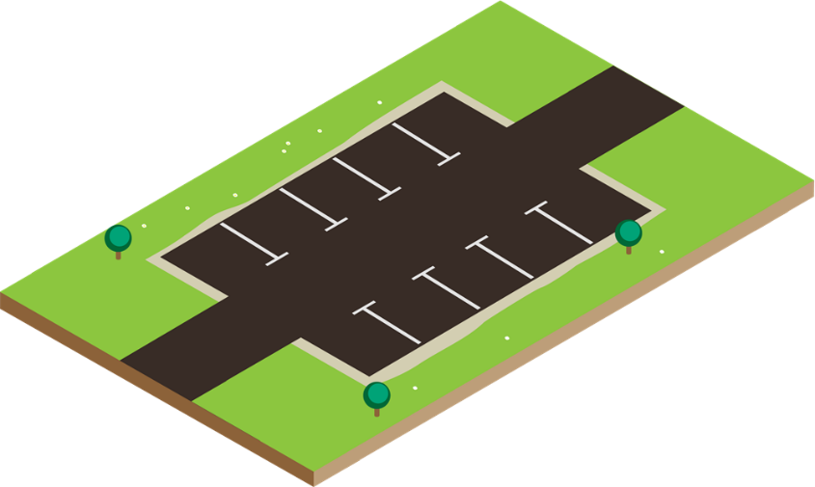

Alternative: Free-Flow Parking
No gates
Payment method or Permits
  Pay-and-Display
  Pay-by-Space
  Meters
Enforcement ?
Notes:
The other approach is free-flow parking, in which there is simply no gate. Free-flow is an enforcement-based approach, in which ensuring compliance is highly dependant on PEOs issuing citations to parking violators.

Slide 9


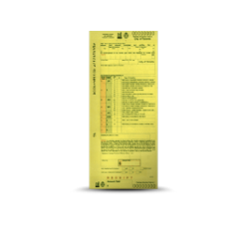
Chronology of an Off-Street Parking Session
Vehicle Arrival
Vehicle enters lot and finds parking
Parking Time Expires
Customers must exit or purchase more time.
Vehicle Exit
Vehicle departs after the session is ended
Enforced
Paid Time
Violation
Parking Time Purchase
Customer purchases parking time at connected pay stations
Enforcement
Officer locates vehicle and issues violation ticket.

Slide 10
What is AutoVu Free-Flow?
AutoVu Free-Flow is an off-street parking enforcement module that tracks unenforced violations in real-time using fixed license plate recognition cameras to enable dynamic patrol route optimization

Slide 11
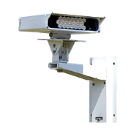


Chronology of an Off-Street Parking Session
Vehicle Arrival
License plate captured by entry ALPR camera
Convenience Time
Paid Time
Parking Time Purchase
Customer purchases parking time at connected pay stations or using mobile apps

Slide 12
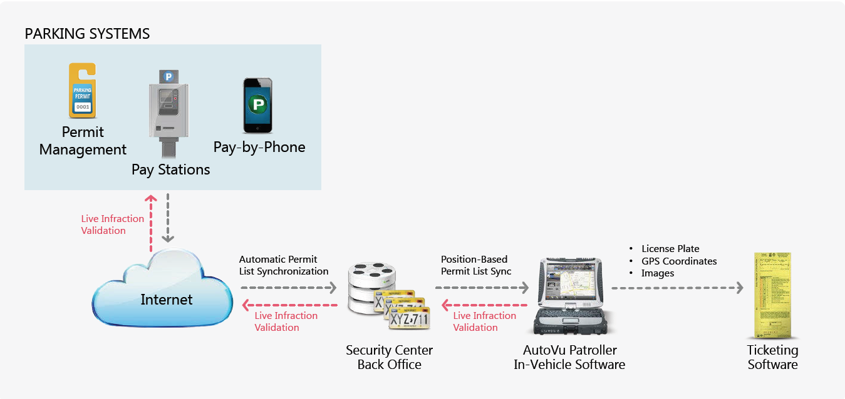
















AutoVu™ Pay-by-Plate Sync

Slide 13

Chronology of an Off-Street Parking Session
Vehicle Arrival
License plate captured by entry ALPR camera
Parking Time Expires
Customers are granted a configurable grace period to exit or purchase more time.
Enforcement
Officer locates vehicle and issues violation ticket. Status updated in back-office
Enforced
Convenience Time
Paid Time
Grace Period
Violation
Parking Time Purchase
Customer purchases parking time at connected pay stations or using mobile apps
Grace Period Ends
Vehicle added to enforcement lists and synchronized to patrol vehicles
Vehicle Exit
License plate captured by exit ALPR camera

Slide 14
What Free-Flow Includes
    Free-Flow Monitoring : Dashboard for overview of Parking situation
    Free-Flow Reports: Summarize violation information by parking lot
    Free-Flow Inventory : Inventory snapshot at any time within the retention period
    Free-Flow Activities : System activities report within a specified time, for a specific plate

Slide 15

Free-Flow Monitoring
Dashboard of key statistics for all parking zones in a single, near real-time snapshot
Displays:
    Parking zone: Name
    Capacity: Total number of parking spaces in a lot.
    In-lot vehicle count: Number of vehicles read on entry minus vehicles read upon exit.
    Occupancy (%): In-lot vehicles/ Capacity x 100
    In-lot violations: Count of violations that haven’t been read on exit.
    In-lot violations (%): In-lot violations/ In-lot vehicles x 100

Slide 16
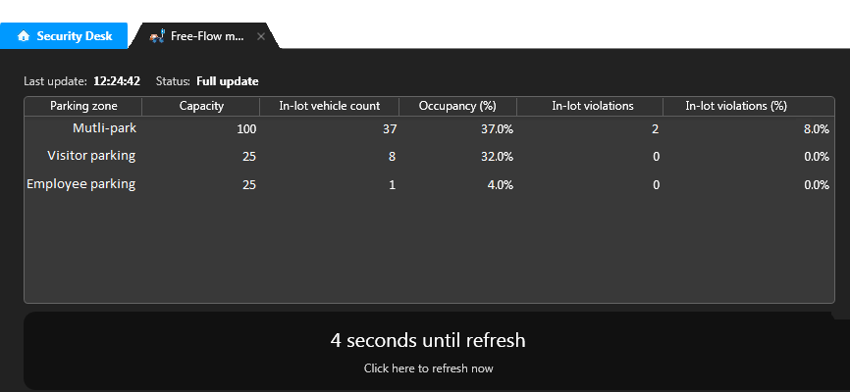
Multi
5
Automatically refreshes every 10 seconds
Countdown to refresh dashboard

Slide 17

Free-Flow Reports
Present violation information by parking zone
Three types of violations:
    In-Lot (formerly “Unconfirmed”): Vehicle that has either stayed past the convenience time without paying or the grace period after having paid but has not left yet. Can be exported as .csv file for in-lot enforcement.
    Exited (formerly “Confirmed”): Vehicle that was an in-lot violation and has exited the lot. Can be exported as .xml file for mail-in ticketing.
    Unknown Vehicle: Vehicle that has exited the lot but was not read upon entry.

Slide 18
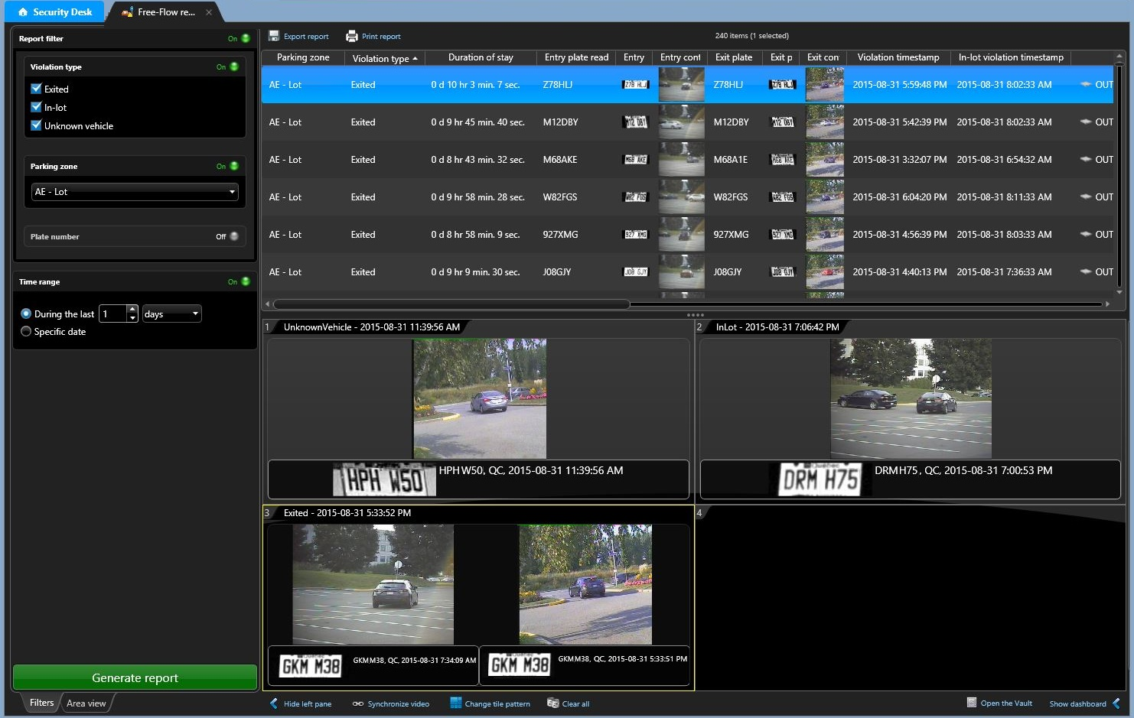
Select which violations to show
Select parking zones to include
Specify plate number and time
Unknown Vehicle violation has a read only on exit
In-lot violation has a read only on entry
Exited violation has reads for both entry and exit

Slide 19

Free-Flow Inventory
Inventory snapshot per parking zone for any time within the database retention period.
Columns:
New Task
Inventory snapshot per parking zone for any time within the database
Filters:
Context image Device Duration of stay Plate image | Plate number Plate state Timestamp Unit
Minimum duration of stay Plate number

Slide 20
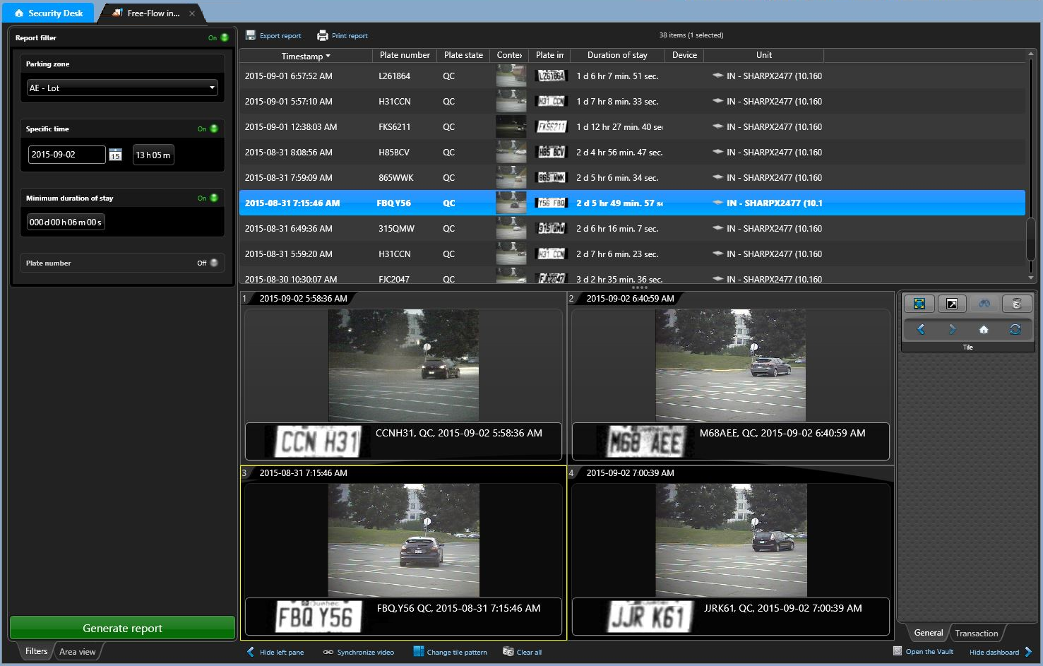
Select time for snapshot of lot occupancy.
Option of specifying plate number

Slide 21

Free-Flow Activities
New Task
Report of plugin activities within a specified time frame
Useful for tracking all activities related to a specific plate number, including lookups to Pay-by-Plate Sync permit providers.
Columns:
    Timestamp
    Parking zone
    Plate number
    Expiration
    Activity Detail

Slide 22
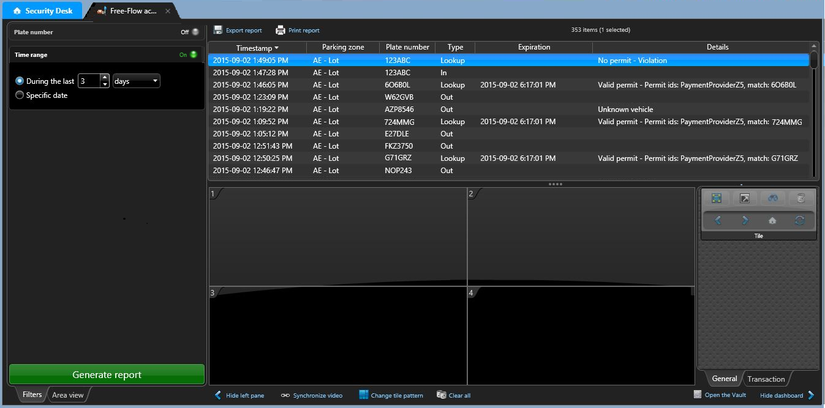
Provides a list of activities in the Free-Flow system, along with type of activity and details where available
Can be set to cover a specific date or a time range
Can be narrowed to particular plates or partial plates
to facilitate investigations

Slide 23
Benefits
Track Off-Street Parking Violations in Real-Time
Increased Efficiency
Enforcement Tracking
Scofflaw Alerts
AutoVu Free-Flow lets you know in real-time how many unenforced violations are present in each lot. Instead of following a pre-determined patrol route, officers can identify the lot with the most unenforced violations.
Parking managers can track enforcement efficiency over time by measuring the percentage of violations which result in tickets being issued.
With fixed ALPR cameras monitoring the entrance of each parking lot, the return of vehicles on a scofflaw list is automatically detected, and a notification can be issued to patrolling officers immediately.

Slide 24
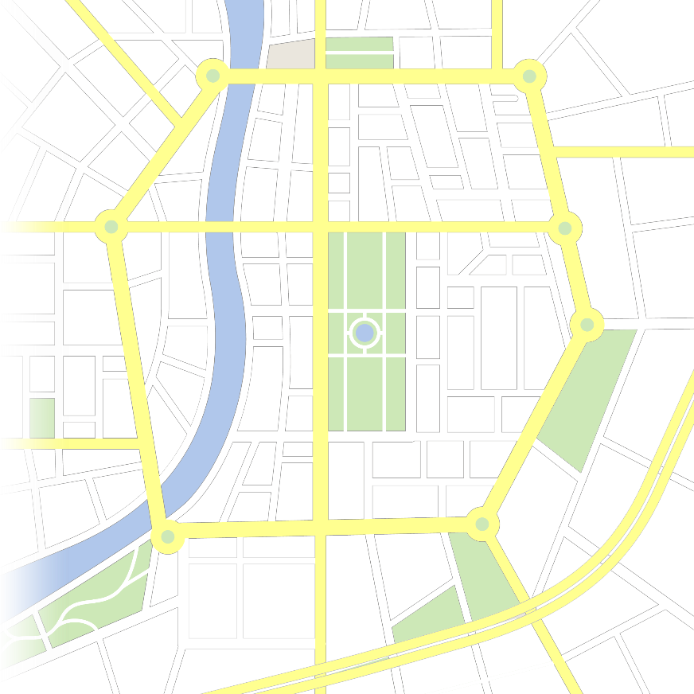
Benefits: Guidance in Real Time
Occupancy
886
Violations
62
Citations
39
D
Occupancy
449
Violations
40
Citations
7
Where do you send your PEO?
A
B
Occupancy
322
Violations
98
Citations
7
Compliance
Capture Rate
Global: 89%
Lot A: 91%
Lot B: 70%
Lot C: 95%
Lot D: 93%
Global: 55%
Lot A: 70%
Lot B: 7%
Lot C: 80%
Lot D: 63%
C
Occupancy
300
Violations
15
Citations
12
Notes:
Boost enforcement productivity by dynamically optimizing patrol routes and focusing on parking lots with unenforced violations
But now you can compare that number of violations to the number of citations issued by your team.
Let’s say I focused my enforcement on the 3 downtown lots, and I got some pretty good results. I distributed 79 citations out of a potential of 117 violations, which is 68% capture rate. But achieving this high capture rate downtown means my PEO was tied up in that area all day, and couldn’t make it to the remote parking lot. Since enforcement is infrequent, compliance is low, and I know I only issued 7 citations, when my PEO had time to do one round late during the day.
My PEO arguably allocated his time well – he ended up focusing on 3 lots with a combined violation count higher than the remote lot. But with ALPR tracking at individual parking lot, you can go beyond optimizing PEO patrols, and measure the potential upside of investing in more enforcement resources.

Slide 25
Free-Flow Limits
Free-Flow does not trigger alarms of events in Security Center.
  Free-Flow does not include payment information from third party payment vendors
Free-Flow does not take direction of travel into account
Free-Flow requires:
1 Sharp for each Entrance
1 Sharp for each Exit
* 1 Sharp cannot be both an Entrance and Exit Sharp for a given lot.

Slide 26
genetec.com
@genetec
cpitman@genetec.com
© 2015 Genetec Inc. All rights reserved. Genetec, Security Center, the Genetec logo and the Genetec Mobius are either trademarks or registered trademarks of Genetec Incorporated. All other logos used herein are the property of their respective owners.

