Slide 1
Plan Manager 10.2 Product Presentation

Slide 2





Genetec at a Glance
Who We Are
  Leading global provider of world class unified IP-based security solutions
  Offices and partners on six continents and sales in over 80 countries
Awards & Achievements
  Ranked #1 VMS Vendor in the Americas in 2011
  Ranked as the top-three vendors in the EMEA territory in 2012
  2012 North American and the 2011 EMEA Axis Communications Application Development Partner of the Year Award
  Genetec’s IP video surveillance system, Omnicast, certified as Approved Product for U.S. Department of Homeland Security
  GTAP awarded 10 best web support sites in 2011 by the Association of Support Professionals

Slide 3
Change the Way Your Department Operates
Unified Security Interface
  A single application for monitoring and carrying out investigations
Hardware
Cameras | Readers | LPR Cameras | Servers | Appliances | Intrusion
  A single unified platform to manage
  security edge devices
Plugins & Add-ons
Intercom | Intrusion Management | POS | Asset Management | Ticketing | Plan Manager
  A single security platform to merge intrusion, mapping, and 3rd party systems
Video
Surveillance
Access Control
License Plate
Recognition
  A single security platform that unifies video, access control, and LPR systems
Video Surveillance | Access Control, License Plate Recognition
Security Center Core Platform

Slide 4
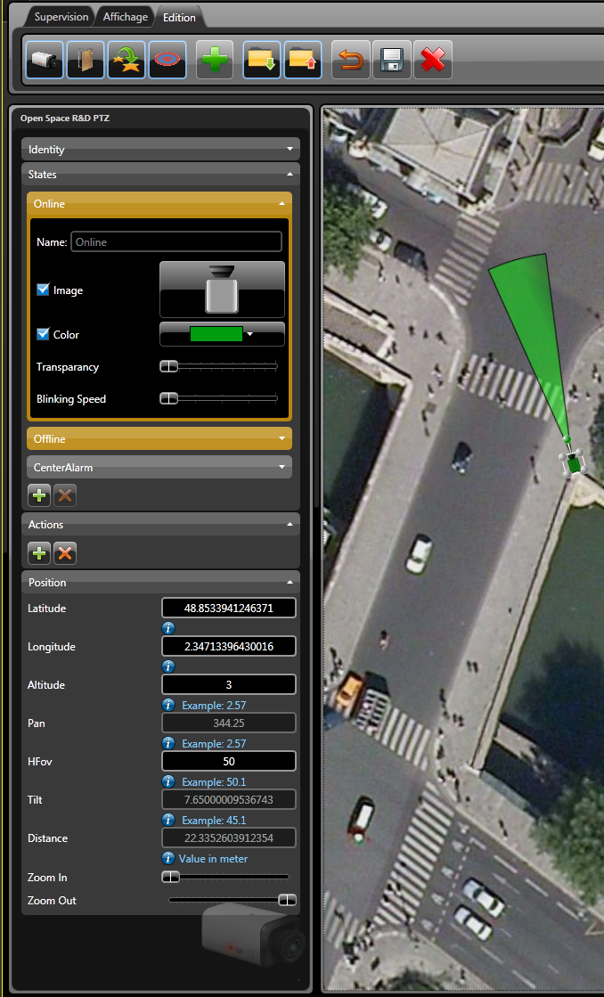
Plan Manager is an Interactive Mapping System Available for Security Center
    プランマネージャは、より優れたセキュリティ環境を可視化するインタラクティブな機能を提供するセキュリティセンターのダイナミックマップベースのコマンドおよび制御モジュールです。
    このツールは、彼らのセキュリティ環境で多数のカメラと実体を管理しているオペレーターに詳細な視覚認識を与えます

Slide 5




Key Vertical Markets
Airports
City-Wide Surveillance
City Surveillance
Education
Stadiums
Notes:
Education or City:
Very Large geographical implentation
Airport:
Complex geographical facilities
Stadium:
Hard to locate a video, by its feed, they look identical

Slide 6
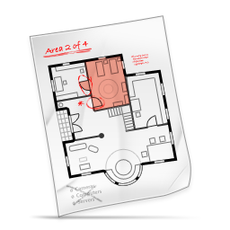



Visualize Your Security Environment
GIS
CAD Files
Raster
Imagery
Dynamic Maps
Map Objects
Hotspots
Favorite Views
Map Links
Alarm Management
State Management
Custom Features
Camera FOV
Lock/Unlock Doors
Arm/Disarm Zones
I/O Monitoring
LPR monitoring
Instant Alerts
Interactive Security
Devices
Notes:
Key Features:
Be instantly alerted of any events, and alarms from your security system, and immediately linked to where alerts have been triggered
Efficiently manage security devices in multi-site and multi-level facilities through dynamic map navigation direction within Security Center
Consolidate detailed, multi-layer maps from various sources, including GIS data, CAD files, and imagery

Slide 7
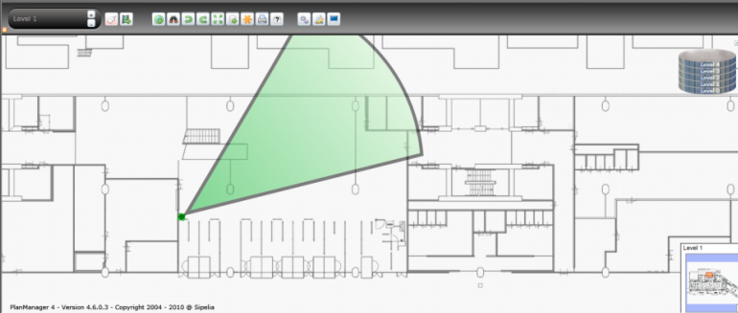
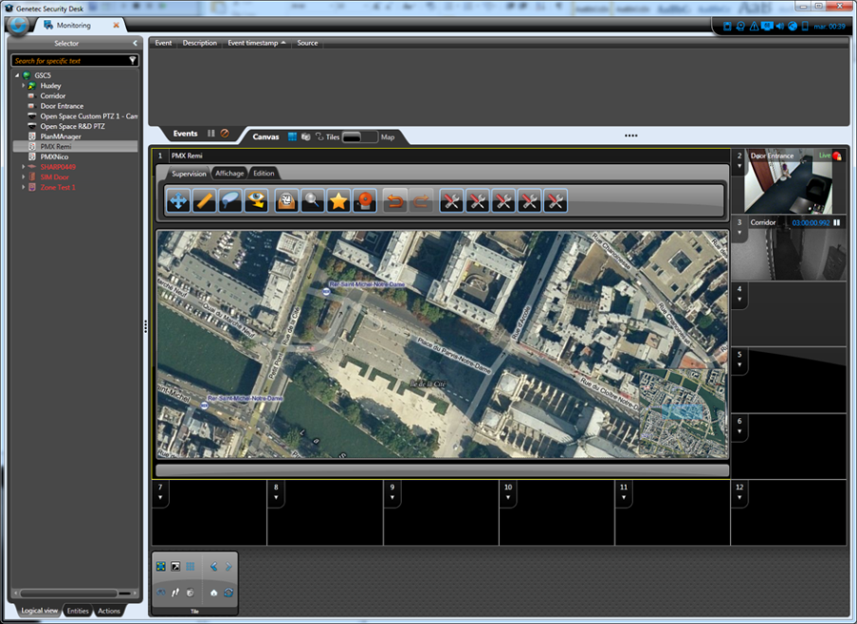
Dynamic Map Navigation
    フロアプランとサイトマップは、多層技術を活用してGISマップと同じ流動性を得ることができます
    解像度とビジュアル品質の向上
    小さな帯域幅とリソースの使用
    簡易なメンテナンス

Slide 8
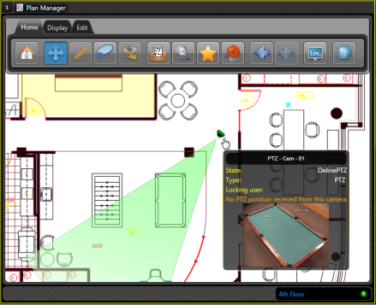
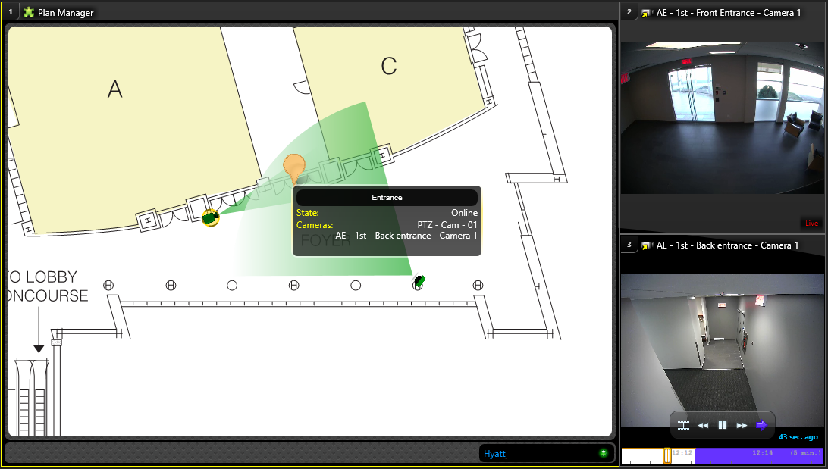
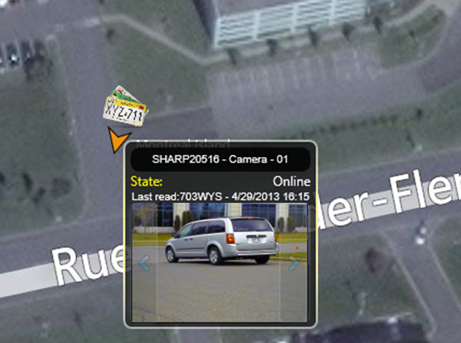
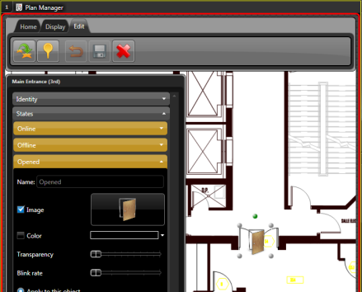
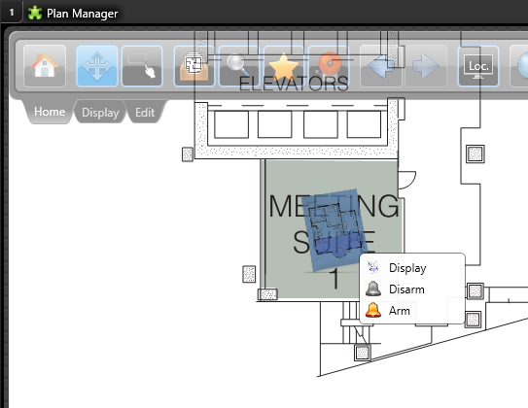
Integrate All Security Devices & Operational Tasks
Cameras
Hot Spots
LPR
Doors
Custom Objects & Actions
Areas
Input and Outputs
Intrusion Zones
Notes:
Cameras
Accurate FoV
Interactive PTZ control
PTZ lock
Hot Spots
Rapid multi-camera display linked to hot spots
Auto position PTZ on relative or preset
Linked Alarm State (New 10.2)
Fixed LPR (New 10.2)
Last Read
Last hit
Context Feed display
Doors
Unlock Action
Open/Close Status
Lock/Unlock Status
Areas
Area fit the location with polygon
Armed/Disarm Status for Intrusion Area
People Counting
Display the CH presence by their picture (New 10.2)
Input/Output (New 10.2)
Monitor any input of SC (door, cameras, zones)
Trigger action to any output of the system (door, cameras, zones)
Map Links
Link to favorite
Link To Map (New 10.2)
Link private maps to GIS
Custom Objects & Actions
Dynamic objects and alerts
Movable custom object
Custom action triggered from any map object

Slide 9
Rapidly Respond to Alarms and Incidents
    すべてのアラームのリンクされたデバイスをPlan Managerに直接通知
    アラームが発生したサイトを表示する
    マップから直接アラームを確認する
    セキュリティ環境の状態の変化を即時に警告
    イベントが発生したときのオブジェクト状態の動的変化（アイコン、色、透明度レベルおよび/または点滅速度の変更）
Notes:
Acknowledge the alarm directly from the map

Slide 10
Intuitive Functionality
Intuitive Navigation
Built-in Map Designer
Smart Click Tools
Multi-Touch Support
Notes:
Consolidate and link GIS, private maps, and floor plans
Create favorite views to rapidly navigate to critical areas
Monitor building floors using quick selector

Slide 11
Thank you

Slide 12



System Architecture
Plan Manager
Private Maps
Map objects and configuration
Security System Command and control
GIS Maps
Plan Manager Server
Open Geospatial
Consortium
Security Center
SQL
Map folder
SC Directory
SQL
GIS Server
Data Server
Map Server

Slide 13
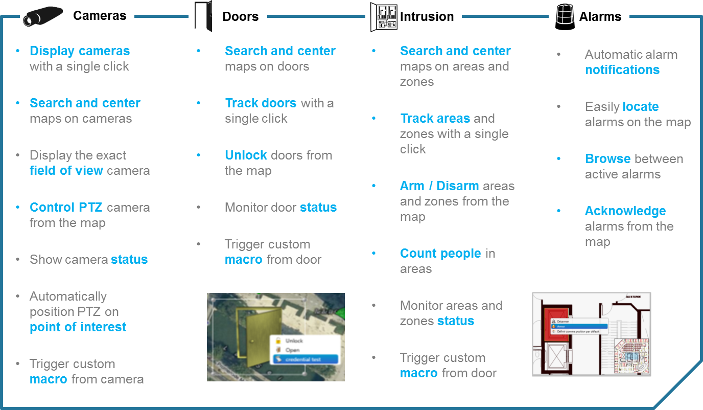
Unified Mapping System

Slide 14
Map Designer
A few simple steps
  PDF（CADからのインポート）またはGISサーバーへのリンク
  ツリー、カメラ、ドア、エリア、ゾーン、I / Oからエンティティをドラッグ＆ドロップする
  PTZの高度と回転角度を調整する
  オプションの地図オブジェクトを追加する：マップリンク、アクションスポット、お気に入りビュー
  状態を編集し、エンティティ状態、アラームまたはカスタムイベントにバインドする
  エンティティが表示されるズームレベルを選択

